Slide 1
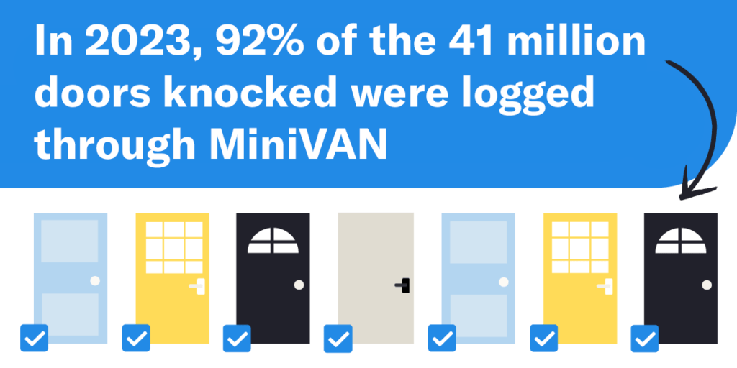
MiniVan basics to help you get ready to canvass
What is MiniVAN?
MiniVAN is a mobile canvassing application that allows political campaigns and organizations to conduct door-to-door canvassing using smartphones or tablets.
It’s the best and most widely used canvassing app in the Democratic and progressive political space.
Up and down the ballot, candidates and causes use it to power their traditional or distributed canvassing operations and win elections across the country.
To use the platform effectively, there are certain steps you can take to help prepare your volunteers to use the app and share tips to make their canvassing more efficient.
We will cover the basics today.
Source: ngpvan https://www.ngpvan.com/blog/canvassing-with-minivan/

Slide 2
MiniVan basics to help you get ready to canvass
Getting started …
Get the app
Create an account
Load your canvass
Have a conversation
Finish your shift
Download the canvassing app from your device's app store and install it. |  | Open the app, sign up with your details, and verify your email. If you have an account, log in. |  | Navigate to enter the unique code and view the list of households and routes for your canvassing efforts. |  | Select a household, introduce yourself, follow the script, and record responses in the app. |  | Return to the main menu to finish and to sync your data and complete your canvassing.
Source: PA Dems https://www.padems.org/wp-content/uploads/2020/10/PA-FINAL-Canvass-MiniVAN-Users-Guide.pdf

Slide 3
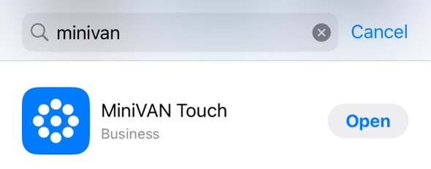
Download the canvassing app from your device's app store and install it.
Get the app
1. Download the App on your phone:
The first step in preparing to canvass with MiniVAN is to download the app.
Go to the iTunes or Google Play Store to search for and download MiniVAN.

Slide 4
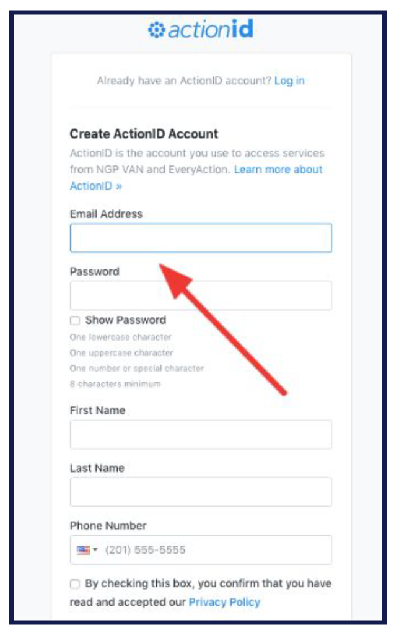
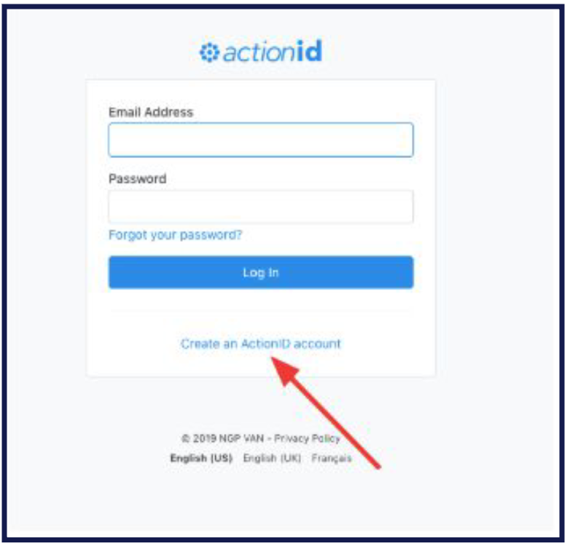
Open the app, sign up with your details, and verify your email. If you have an account, log in.
Create an account
2. Open the App and Login/ Set Up Your Account:
Once installed, open the app.
If you already have an actionid use it to log in.
If you do not you will need to create an account to access MiniVAN. To create an account click Create an actionid account.
If you forget your password you can reset it by tapping “Forgot your password ?”
3. Login/ Set Up Your Account:
Create your Account: To create your
account fill out the requested fields

Slide 5
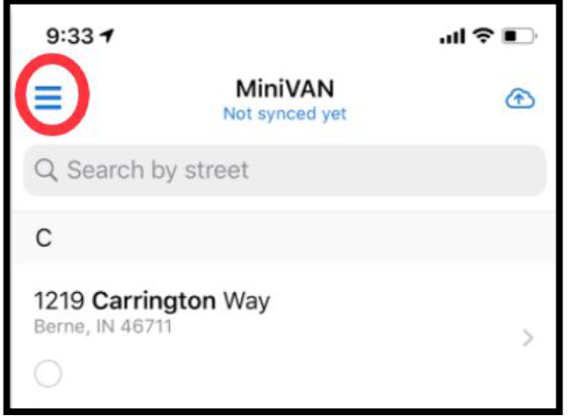
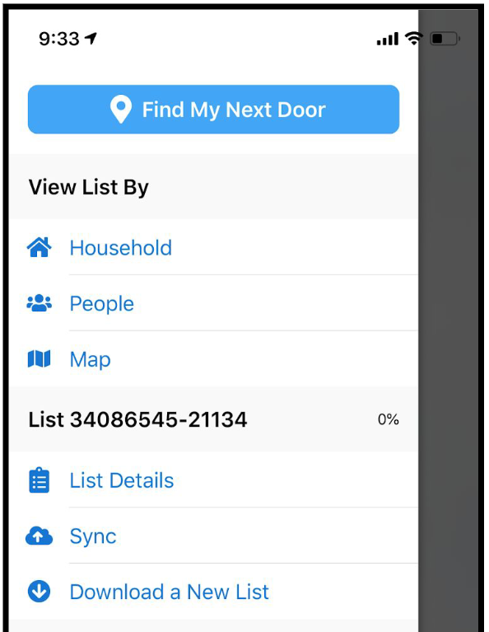
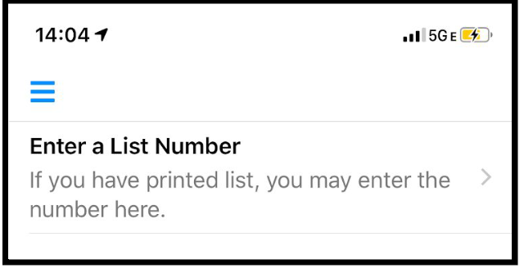
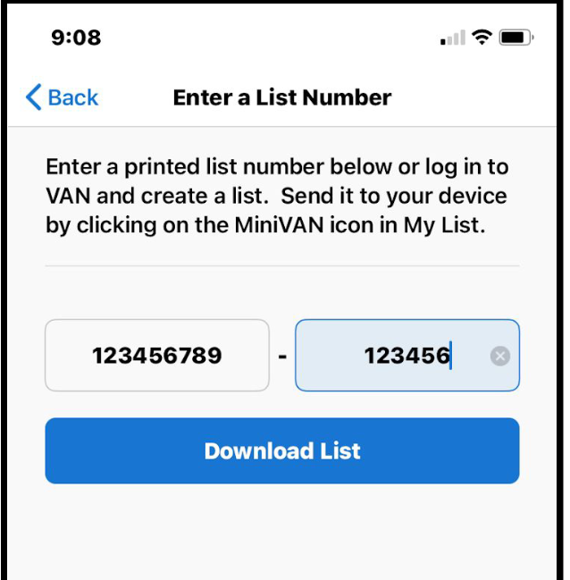
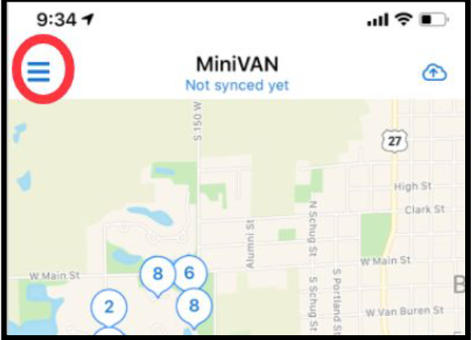
Navigate to enter the unique code and view the list of households and routes for your canvassing efforts.
Load your canvass
3. Get your list:
Enter the provided list number and download the list. Or use the new scan feature to scan the list number.
Use a new list number each time you canvass.
Don’t forget the dash in your list number and enter it accurately.
4. Switching views:
After downloading the list, you will see a list of addresses. Click the three lines on the top left to switch between the list and map view.

Slide 6
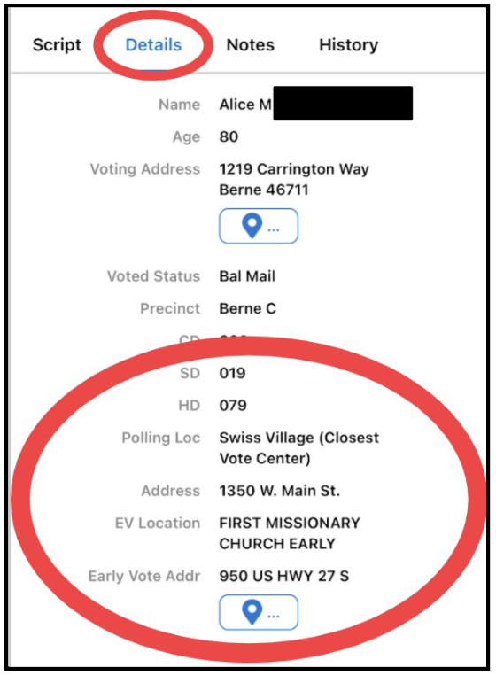
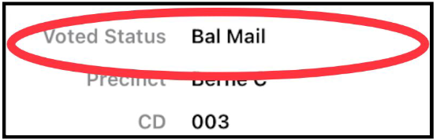
Navigate to enter the unique code and view the list of households and routes for your canvassing efforts.
Load your canvass
5. Voter details:
Under ‘details’ in the voter’s profile, you will see their Early Voting and Election Day polling locations and their voting status.
Next to “Voted Status,” if the voter has requested and been mailed their ballot, it will be noted as “Bal Mail.” You will make a plan with them to return their ballot as early as they can and walk them through each of the steps to doing so successfully.

Slide 7
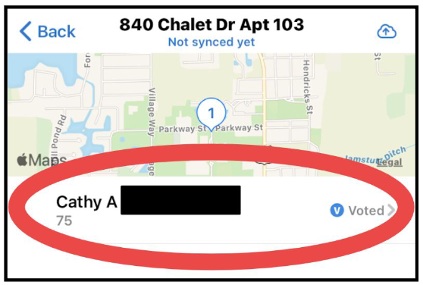
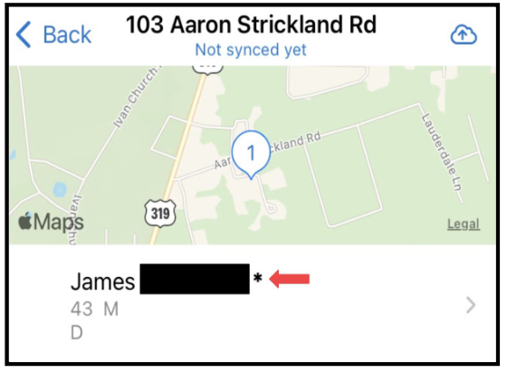
Navigate to enter the unique code and view the list of households and routes for your canvassing efforts.
Load your canvass
You will also see that a blue “V” next to “Voted” will show up next to the voter’s name if the voter has already cast their ballot.
Finally as shown below, there will be an asterisk next to a voter’s name if someone in the household is over the age of 75. In that instance, you will just leave literature for that household and not knock on the door.

Slide 8
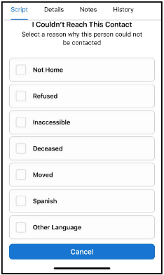
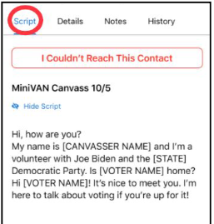
Select a household, introduce yourself, follow the script, and record responses in the app.
Have a conversation
6. Go to contact’s page:
Select the voter you will be talking to and you will see the script you will be using.
7. Can’t reach the voter:
Select, “I Couldn’t Reach This Contact” if you do not have a conversation with the voter and choose the reason why.
On an iPhone, you can swipe right on a voter’s name from the list view to mark them as “Not Home.”

Slide 9
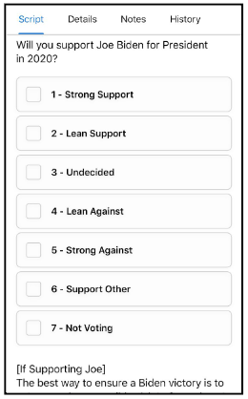
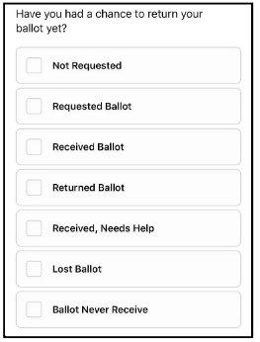
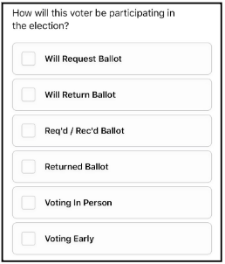
Select a household, introduce yourself, follow the script, and record responses in the app.
Have a conversation
8. Can reach the voter:
If you do speak to the contact, follow the script and record the voter’s response to each question.
The questions on your script may differ from the example, but tap the appropriate box and a checkmark will appear next to the option you marked.
If a voter has requested and been mailed a ballot, you will mark the results of that conversation using this part of the script shown below.

Slide 10
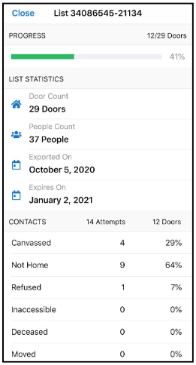
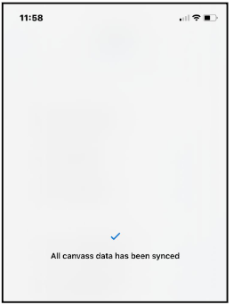

Return to the main menu to finish and to sync your data and complete your canvassing.
Finish Your Shift
9. Check your progress
Select “List Details” to check your progress.
10. Sync your data:
When you’re done canvassing tap on the cloud on the top right corner of the app to send your results to our database - VAN.
Note: Syncing your progress throughout your canvass ensures that data will not be lost and others can see your progress.

Slide 11
General reminders
It’s Arizona! Bring water and wear sunblock and comfortable clothes. Your health and safety is #1 so do only what you’re comfortable doing.
Try to complete your full list. There are a lot of voters we need to talk to between now and Election Day.
Tag every interaction and conversation with the relevant tag.
If you do not know the answer to a question, that’s ok. For policy questions, refer the voter to our LD or candidates’ websites and the literature. For questions on voting that you don’t know, refer the voter to iwillvote.com.
Come prepared with a fully charged phone and portable charger if accessible to you.

