Slide 1
Canvassing with the Pros
Featuring presentation from
Jared Goldberg
LD8 Coordinated Campaign Leader

Slide 2
Welcome!
If you’re not yet a PC, become a PC!
What is a PC?
The office of Precinct Committee Person (PC) is an elected (or appointed) official with responsibilities prescribed by the state of Arizona and the Arizona Democratic Party.
Why are PCs Important?
PCs represent the Arizona Democratic Party at the precinct level.
What are PCs expected to do?
CANVASS
REGISTER VOTERS
ADD VOTERS TO THE ACTIVE EARLY VOTING LIST (AEVL)
GET OUT THE VOTE
ENGAGE NEIGHBORHOOD DEMOCRATS
PCs are the link between the Arizona Democratic Party and the voters in their precinct.
PCs are the ground game of the Arizona Democratic Party.
PCs play an important role in building the long-term infrastructure of the party from the grassroots up.

Slide 3
What we will cover in this session:
Our goals for the session
Canvassing Pro, Jared Goldberg’s training to help new canvassers and experienced canvassers to GOTV
Dates and times to practice your canvassing skills with Jared and the Coordinated Campaign
MiniVan basics to help you get ready to canvass
Question and answer time

Slide 4



Our goals for the session
Amplify Our GOTV Efforts and ensure a successful Get Out The Vote (GOTV) campaign
Strengthen LD8 PC engagement because you are an invaluable asset and your participation in GOTV can significantly impact our collective impact.
Equip you - PCs and volunteers - with advanced canvassing techniques and the knowledge to effectively use Minivan.

Slide 5

Canvassing with Jared Goldberg
Introduction:
Hi! Is this ? Hey, my name is and I’m a volunteer here in with AZ Democratic Party. How are you doing today?
Issue Identification:
Q1: We are talking to voters today to see what issues they care about most. What issue do you believe needs to be addressed in your community?
● Healthcare ● Economy ● Education ● Immigration ● Democracy
Voter Identification:
Q2: As the general elections are only a few short months away, do you know who you’re voting for in the 2024 Presidential Race?
● [If BIDEN] Transition to Question 3.
● [If UNDECIDED] Share why you are voting to re-elect President Biden and VP Harris.
● [If TRUMP] Thank you for sharing and for your time. Have a good day. End the conversation.
[CTV ASK] Amazing! We are knocking doors to collect Commit to Vote Cards. CTV's are a reminder to vote! Closer to the November election, we will send these back to your homes to remind you to go and vote!
Can I count on you to commit to vote this year!?

Slide 6
Canvassing with Jared Goldberg
Democrat Identification:
Q3: Can we count on your vote for Democrats at all levels of the ballot in November, including to flip the Arizona state legislature?
● [If DEMOCRAT] Transition to volunteer ask.
● [If UNDECIDED] Totally understand, it’s a big decision. May I ask what’s holding you back from full support right now?
● [If REPUBLICAN] Thank you for sharing and for your time. Have a good day. End the conversation.
Volunteer Ask:
Q4: There are lots of ways to get involved with the AZ Democrats here in , and we are going to need all the help we can get to protect democracy and win this election. We’re looking for people to join us in all sorts of ways from knocking doors, making calls, or sharing content online. Will you join me in taking action with the campaign?
● [If YES] Great! I’ll make sure to mark that here and someone from the campaign will reach out to you in the new days
● [If MAYBE] No worries! Why don’t I put you down as a “maybe” and the campaign can follow-up with you in a couple of days.
● [If NO] No worries! You can always go to mobilize.us/jumpstartaz to find the latest volunteer opportunities.
Closing:
Thank you so much for taking the time to speak with me today, and have a great day!

Slide 7
Join these opportunities to practice and improve your canvassing skills!
Coordinated Campaign Events
Saturday, July 20 - 9am-12pm in Tempe - Knock Doors for AZ Dems in Tempe! - sign up in Mobilize
Sunday, July 21-
  9am-12pm in Tempe - Knock Doors for AZ Dems in Tempe! - sign up in Mobilize
  4-5pm - Virtual OutReach with AZ Dems! - sign up in Mobilize

Slide 8
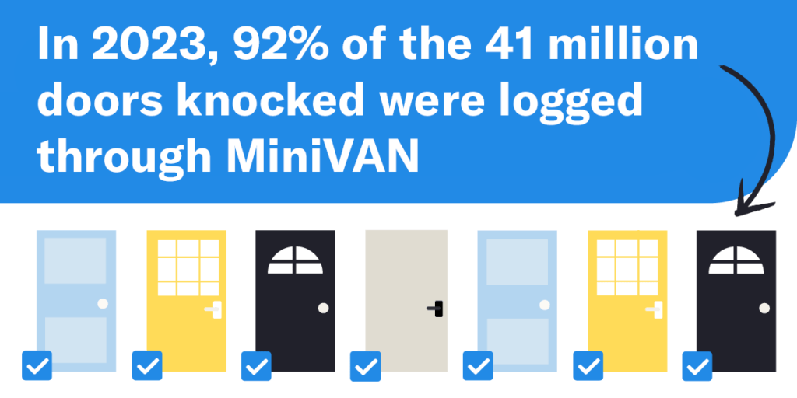
MiniVan basics to help you get ready to canvass
What is MiniVAN?
MiniVAN is a mobile canvassing application that allows political campaigns and organizations to conduct door-to-door canvassing using smartphones or tablets.
It’s the best and most widely used canvassing app in the Democratic and progressive political space.
Up and down the ballot, candidates and causes use it to power their traditional or distributed canvassing operations and win elections across the country.
To use the platform effectively, there are certain steps you can take to help prepare your volunteers to use the app and share tips to make their canvassing more efficient.
We will cover the basics today.
Source: ngpvan https://www.ngpvan.com/blog/canvassing-with-minivan/

Slide 9
MiniVan basics to help you get ready to canvass
Getting started …
Get the app
Create an account
Load your canvass
Have a conversation
Finish your shift
Download the canvassing app from your device's app store and install it. |  | Open the app, sign up with your details, and verify your email. If you have an account, log in. |  | Navigate to enter the unique code and view the list of households and routes for your canvassing efforts. |  | Select a household, introduce yourself, follow the script, and record responses in the app. |  | Return to the main menu to finish and to sync your data and complete your canvassing.
Source: PA Dems https://www.padems.org/wp-content/uploads/2020/10/PA-FINAL-Canvass-MiniVAN-Users-Guide.pdf

Slide 10
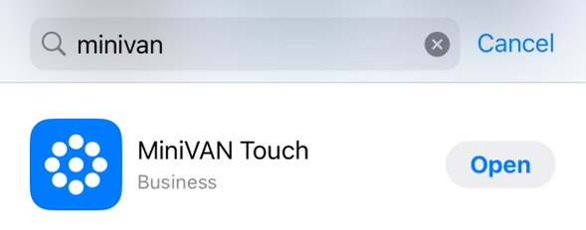
Download the canvassing app from your device's app store and install it.
Get the app
1. Download the App on your phone:
The first step in preparing to canvass with MiniVAN is to download the app.
Go to the iTunes or Google Play Store to search for and download MiniVAN.

Slide 11
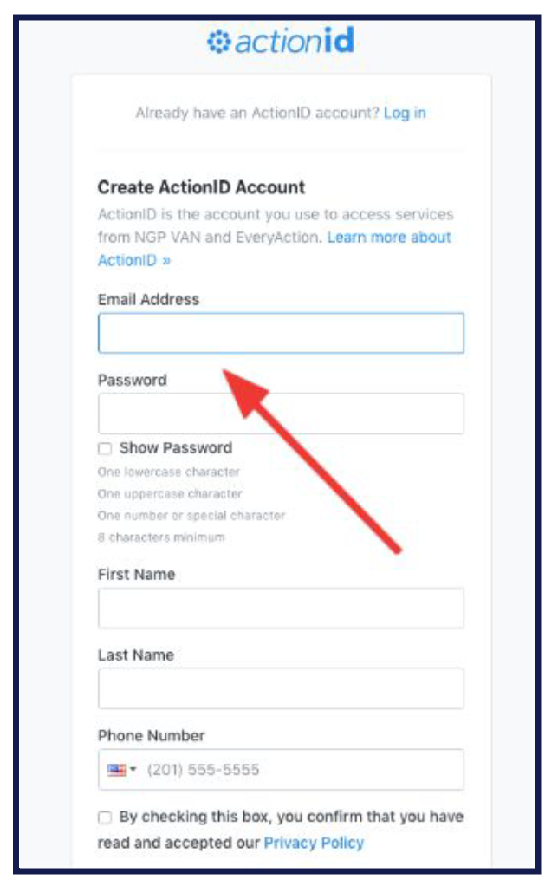
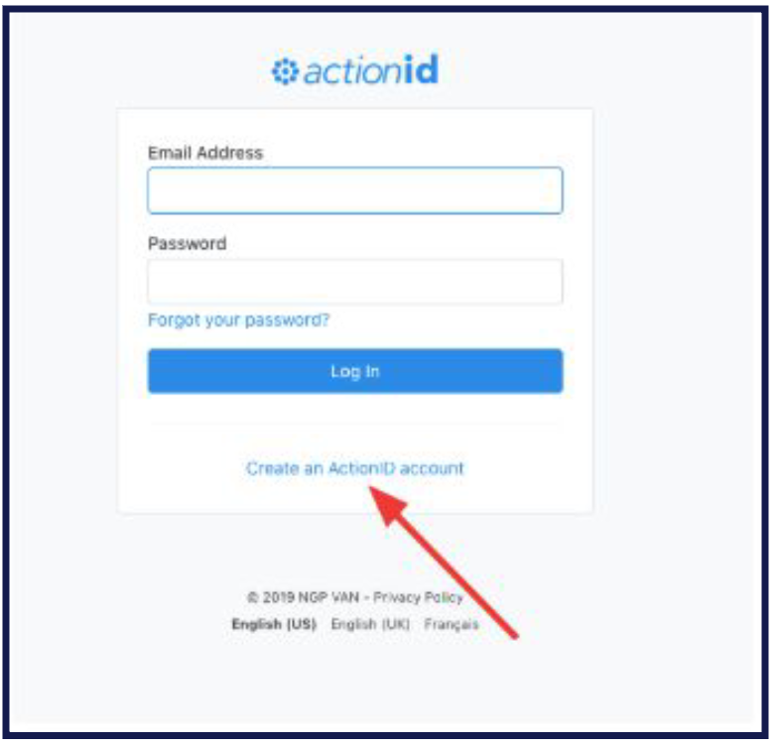
Open the app, sign up with your details, and verify your email. If you have an account, log in.
Create an account
2. Open the App and Login/ Set Up Your Account:
Once installed, open the app.
If you already have an actionid use it to log in.
If you do not you will need to create an account to access MiniVAN. To create an account click Create an actionid account.
If you forget your password you can reset it by tapping “Forgot your password ?”
3. Login/ Set Up Your Account:
Create your Account: To create your
account fill out the requested fields

Slide 12
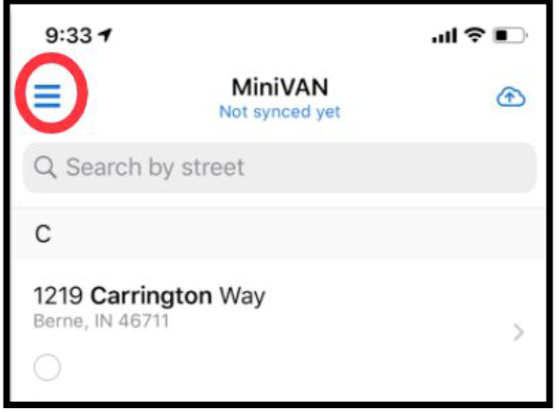
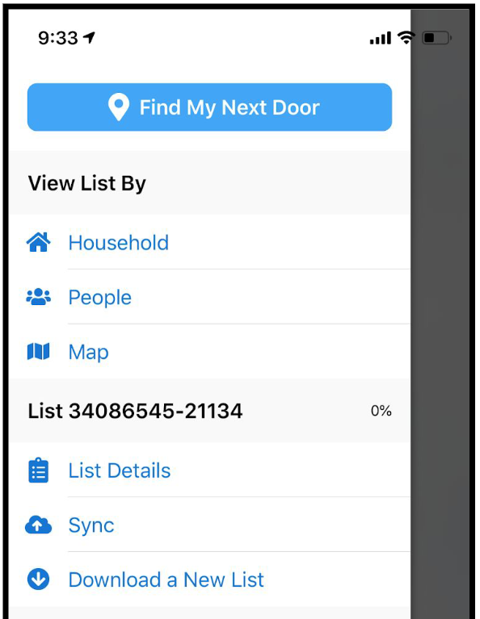
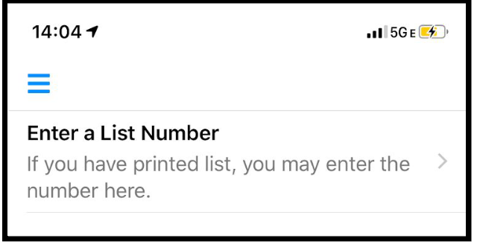
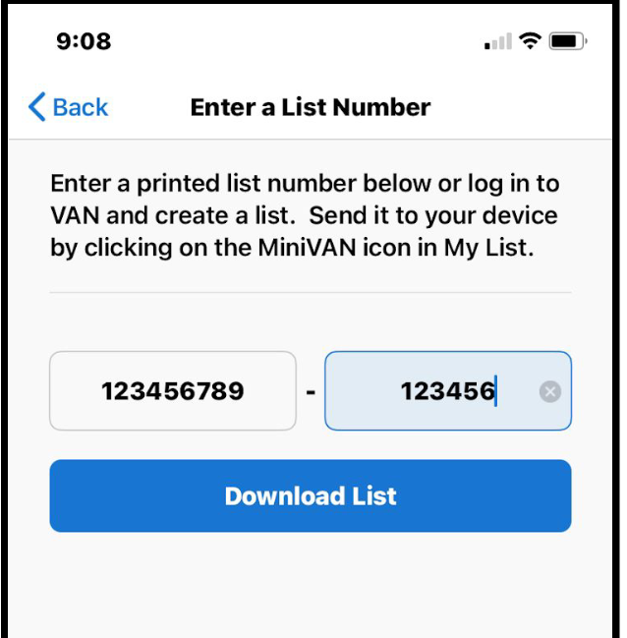
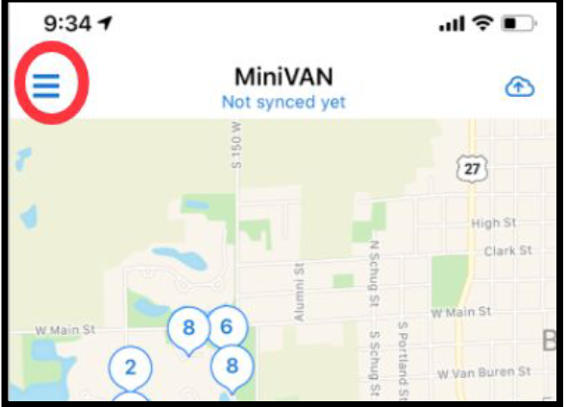
Navigate to enter the unique code and view the list of households and routes for your canvassing efforts.
Load your canvass
3. Get your list:
Enter the provided list number and download the list. Or use the new scan feature to scan the list number.
Use a new list number each time you canvass.
Don’t forget the dash in your list number and enter it accurately.
4. Switching views:
After downloading the list, you will see a list of addresses. Click the three lines on the top left to switch between the list and map view.

Slide 13
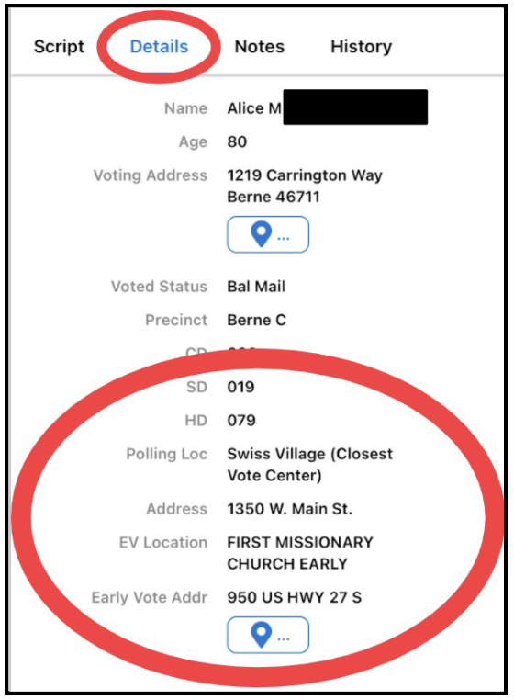
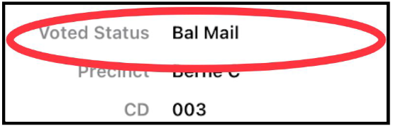
Navigate to enter the unique code and view the list of households and routes for your canvassing efforts.
Load your canvass
5. Voter details:
Under ‘details’ in the voter’s profile, you will see their Early Voting and Election Day polling locations and their voting status.
Next to “Voted Status,” if the voter has requested and been mailed their ballot, it will be noted as “Bal Mail.” You will make a plan with them to return their ballot as early as they can and walk them through each of the steps to doing so successfully.

Slide 14
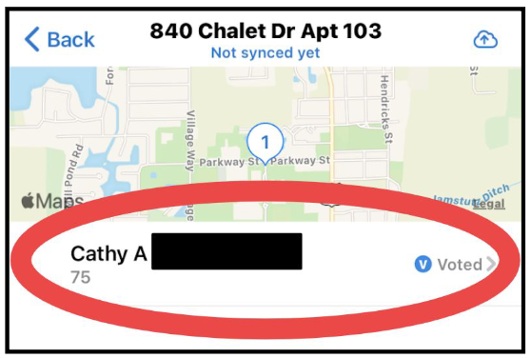
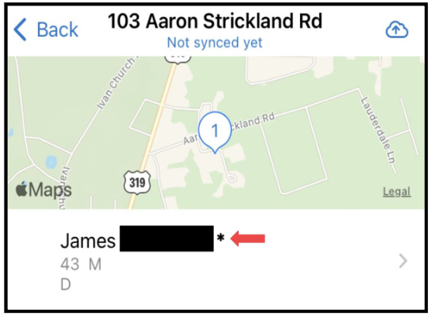
Navigate to enter the unique code and view the list of households and routes for your canvassing efforts.
Load your canvass
You will also see that a blue “V” next to “Voted” will show up next to the voter’s name if the voter has already cast their ballot.
Finally as shown below, there will be an asterisk next to a voter’s name if someone in the household is over the age of 75. In that instance, you will just leave literature for that household and not knock on the door.

Slide 15
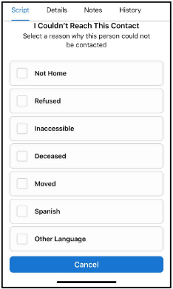
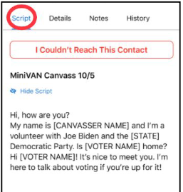
Select a household, introduce yourself, follow the script, and record responses in the app.
Have a conversation
6. Go to contact’s page:
Select the voter you will be talking to and you will see the script you will be using.
7. Can’t reach the voter:
Select, “I Couldn’t Reach This Contact” if you do not have a conversation with the voter and choose the reason why.
On an iPhone, you can swipe right on a voter’s name from the list view to mark them as “Not Home.”

Slide 16
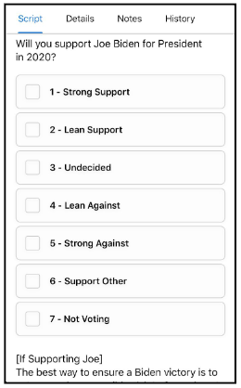
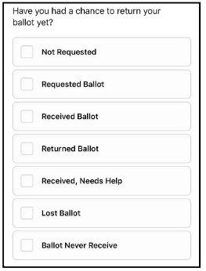
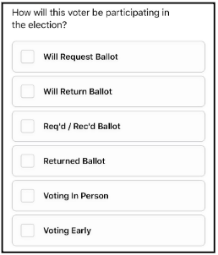
Select a household, introduce yourself, follow the script, and record responses in the app.
Have a conversation
8. Can reach the voter:
If you do speak to the contact, follow the script and record the voter’s response to each question.
The questions on your script may differ from the example, but tap the appropriate box and a checkmark will appear next to the option you marked.
If a voter has requested and been mailed a ballot, you will mark the results of that conversation using this part of the script shown below.

Slide 17
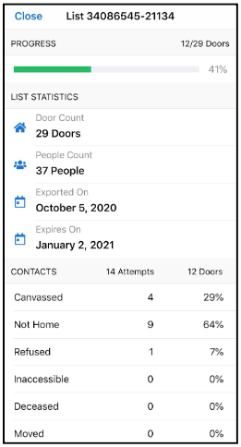


Return to the main menu to finish and to sync your data and complete your canvassing.
Finish Your Shift
9. Check your progress
Select “List Details” to check your progress.
10. Sync your data:
When you’re done canvassing tap on the cloud on the top right corner of the app to send your results to our database - VAN.
Note: Syncing your progress throughout your canvass ensures that data will not be lost and others can see your progress.

Slide 18
General reminders
It’s Arizona! Bring water and wear sunblock and comfortable clothes. Your health and safety is #1 so do only what you’re comfortable doing.
Try to complete your full list. There are a lot of voters we need to talk to between now and Election Day.
Tag every interaction and conversation with the relevant tag.
If you do not know the answer to a question, that’s ok.
For policy questions, refer the voter to our LD or candidates’ websites and the literature.
For questions on voting that you don’t know, refer the voter to iwillvote.com.
Come prepared with a fully charged phone and portable charger if accessible to you.

Slide 19
Q & A Time

